Slide 1
Introduction to DIGITAL MARKETING

Slide 2
Module objectives
To know to what extent digital technology and media changes existing marketing models and how new models and strategies can be applied to exploit the medium effectively.
How to best integrate and align digital marketing with business and marketing strategies and communications, including dedicated digital transformation programmes and digital marketing strategies where necessary.

Slide 3
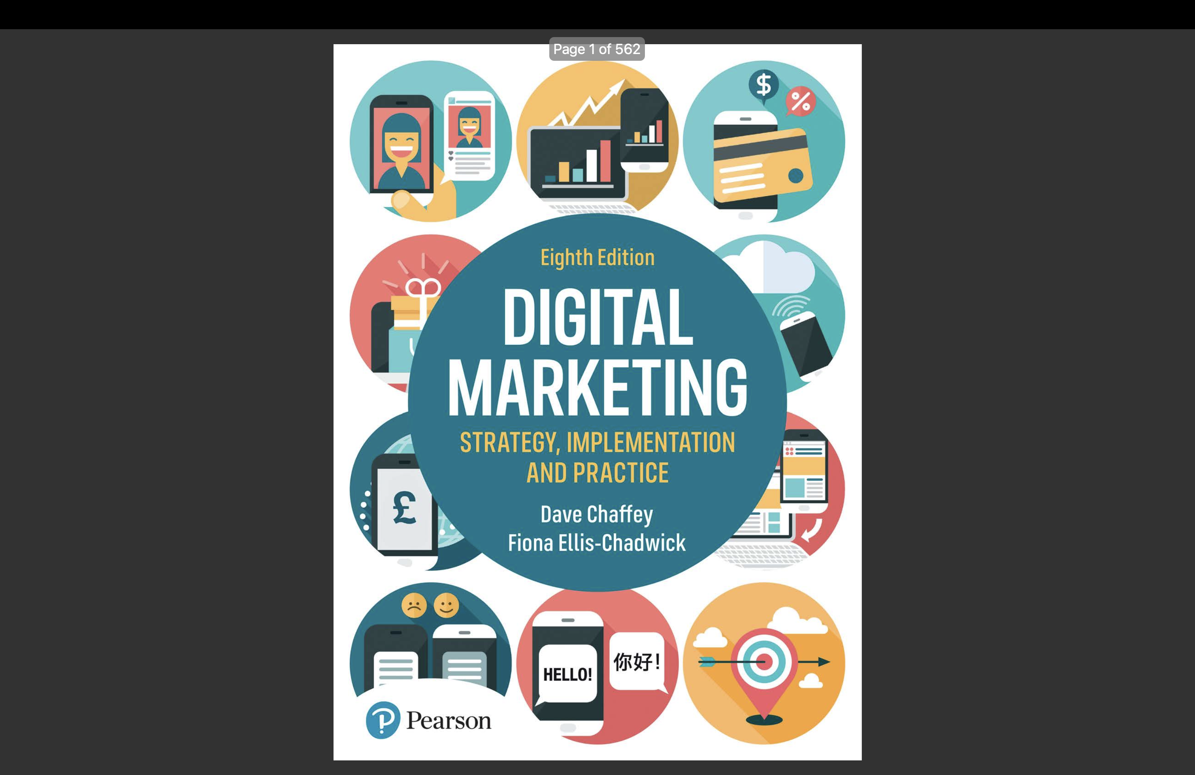
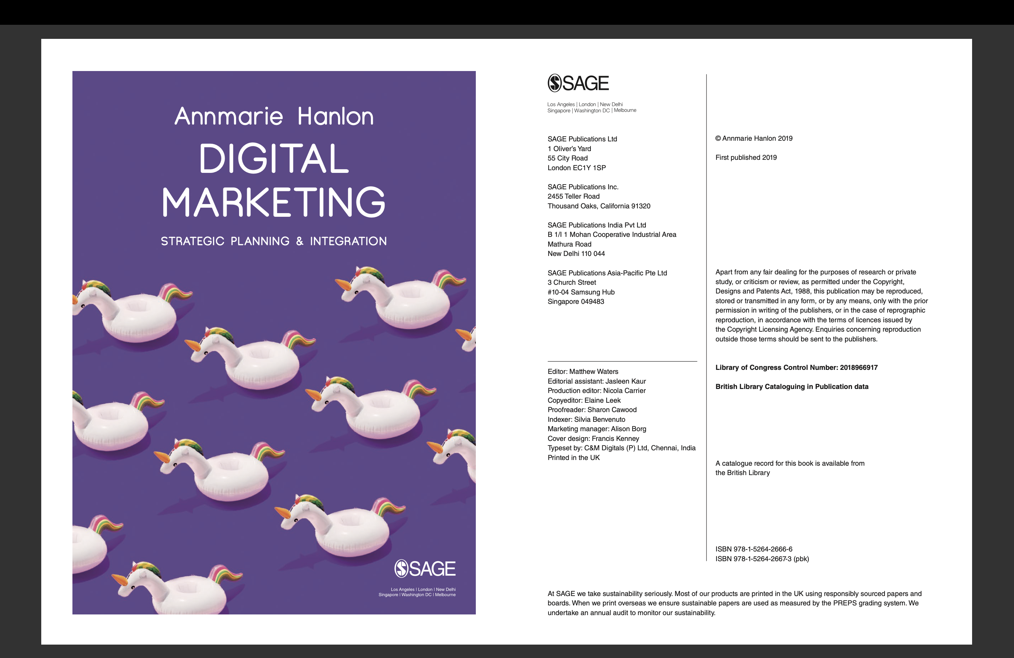
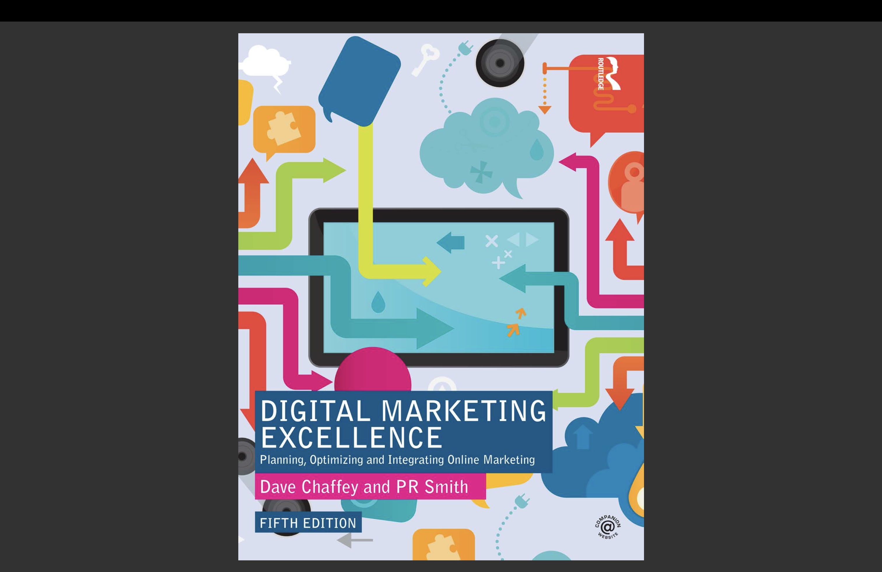
TEXTBOOKS AND COURSE MATERIALS
- Other bibliography in each chapter.
Notes:
Hubspot
Hoosuite
Smartinsights

Slide 4
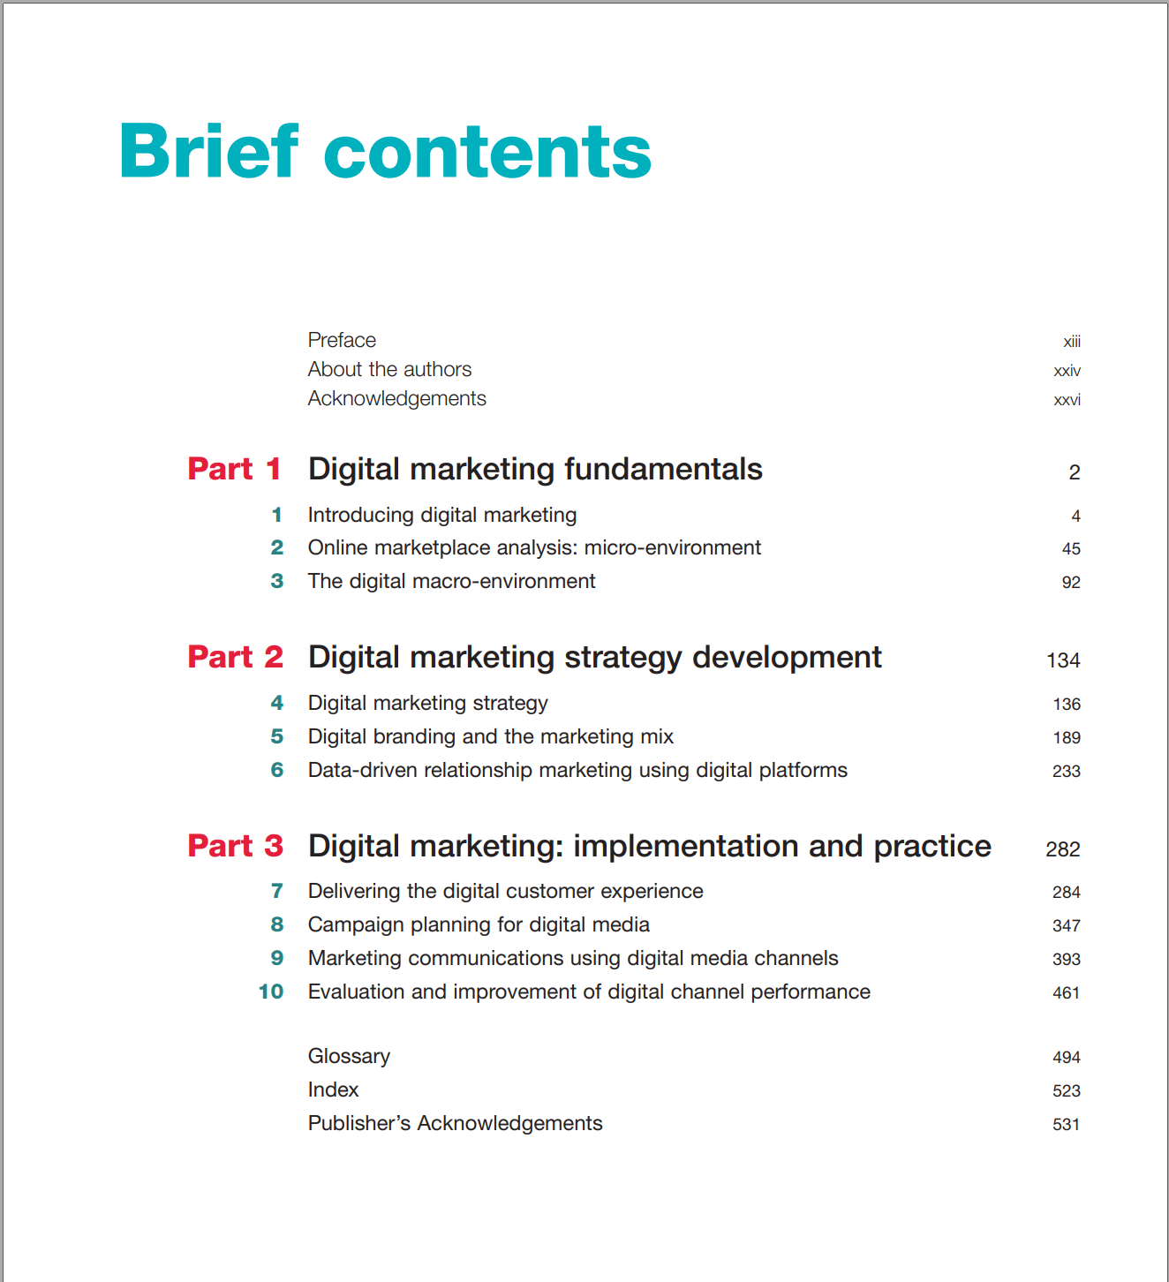
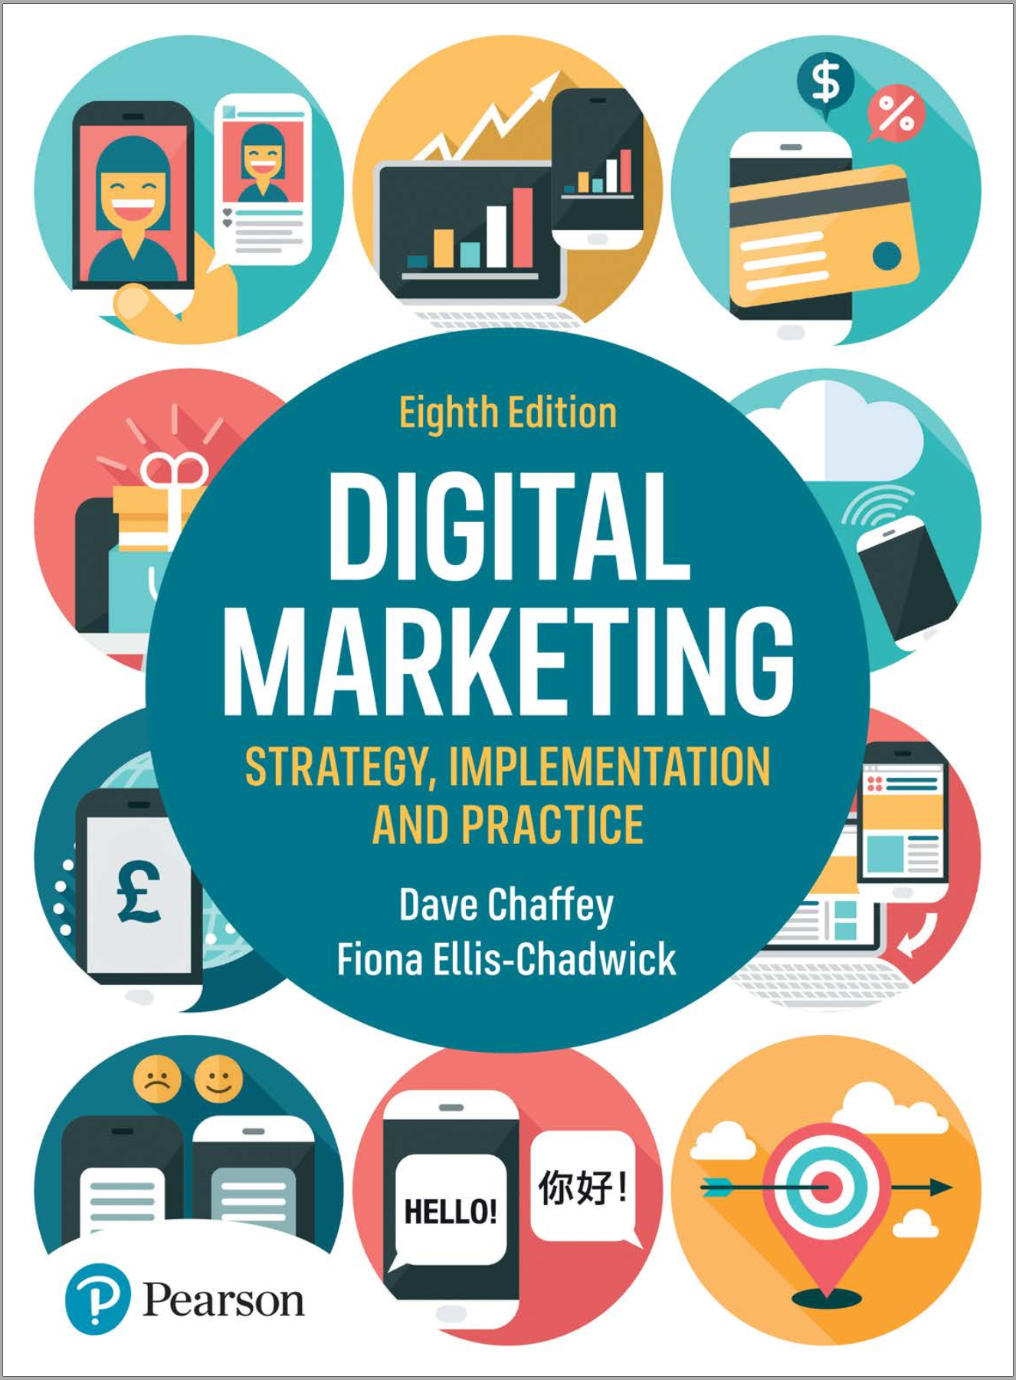
Textbook

Slide 5
Chapter 1: INTRODUCING DIGITAL MARKETING

Slide 6
Chapter content
Overview of Digital Marketing
+ Definition of Digital marketing and related concepts
+ Digital Marketing goals
+ Benefits and key challenges of Digital Marketing
Overview of digital marketing strategy

Slide 7
OVERVIEW OF DIGITAL MARKETING
Concept and nature of Digital Marketing
Digital transformation
Paid – Owned – Earned Media
7Ds of Digital Marketing
Digital Marketing goals
Transactions in Digital Marketing
Benefits and challenges in Digital Marketing

Slide 8
What is Digital Marketing?
Digital marketing can be simply defined as: Achieving marketing objectives through applying digital media, data and technology (Chaffey, 2019)
The application of digital media, data and technology integrated with traditional marketing communications to achieve marketing objectives (Chaffey, 2022)
Digital marketing is the process of planning the product, price, place and promotion of products, services and ideas to meet organizational and individual needs using electronic media and the Internet(Kotler, 2003).

Slide 9
Essence of Digital Marketing
Is the process of planning and implementing an organization's MKT plan in the digital environment;
Using digital channels and media to implement MKT plans, not just implementing communication campaigns on the Internet
Cannot be separated for enterprises operating in the physical environment but must be a consistent part of a common overall strategy (Marketing 4.0).
Not a new concept of MKT but the application and development of the principle of MKT in the digital environment - Marketing 1-2-1

Slide 10
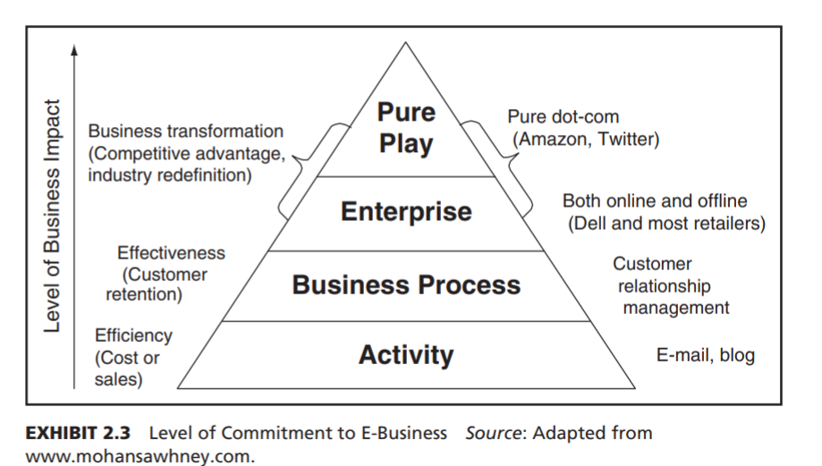
Digital transformation
The evolving pursuit of innovative and agile business and operational models – fuelled by evolving technologies, processes, analytics, and talent – to create new value and experiences for customers, employees, and stakeholders (Analyst Brian Solis, 2017).
A staged programme of organisational improvements to business models, people, process and technologies used for integrated digital marketing in order to maximise the potential business contribution of digital technology, data and media (Chaffey, 2022)
Notes:
Quá trình chuyển đổi số là sự theo đuổi các mô hình hoạt động kinh doanh linh hoạt và sáng tạo - được thúc đẩy bởi sự phát triển công nghệ, sự thay đổi quy trình, khả năng phân tích - để tạo ra giá trị và trải nghiệm mới cho khách hàng, nhân viên và các bên liên quan (Dave Chaffey, 2022).

Slide 11
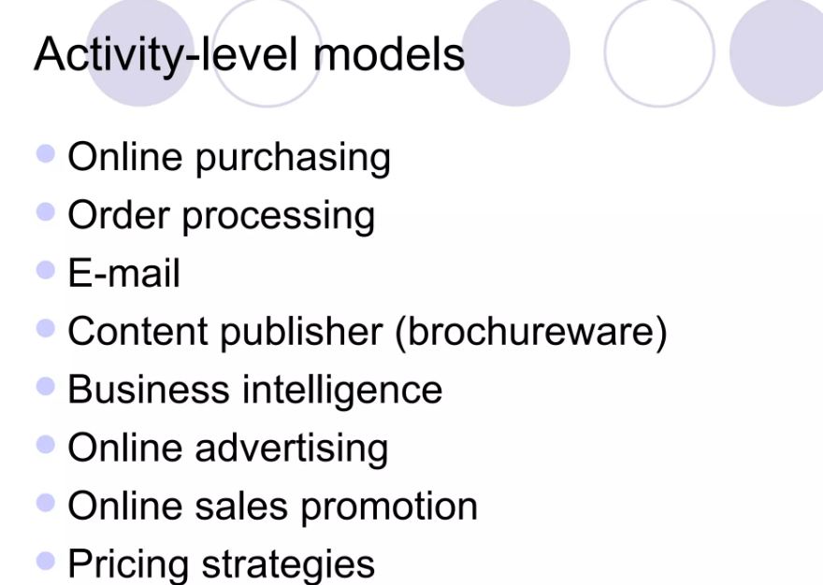
DIGITAL TRANSFORMATION
Digital transformation

Slide 12
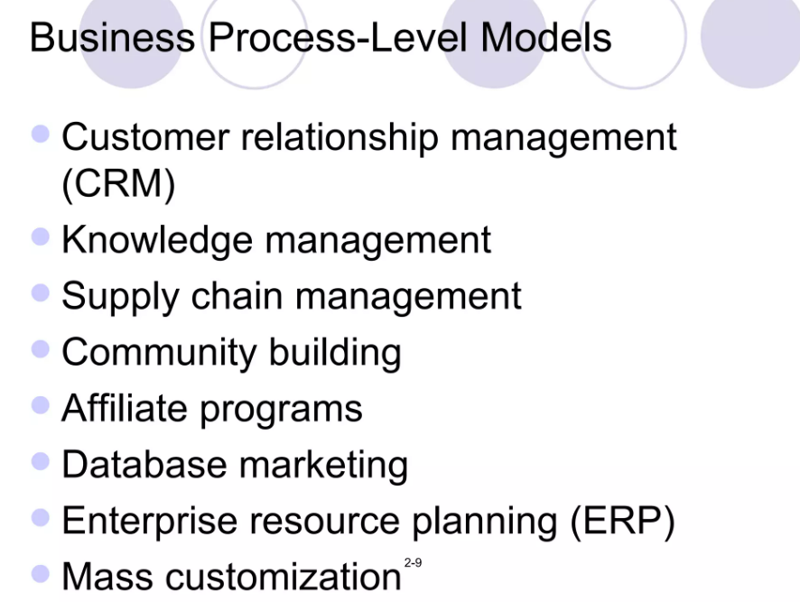
Digital transformation

Slide 13
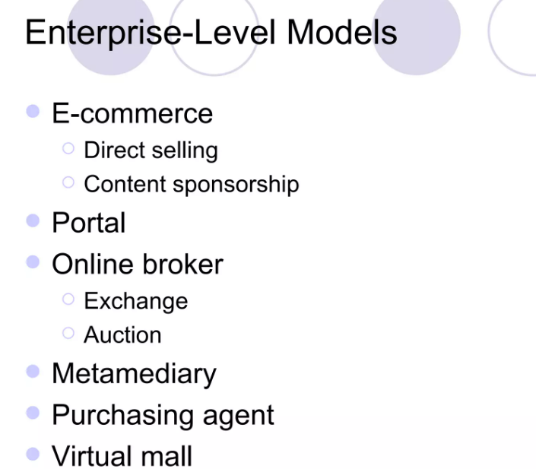
DIGITAL TRANSFORMATION
Digital transformation

Slide 14
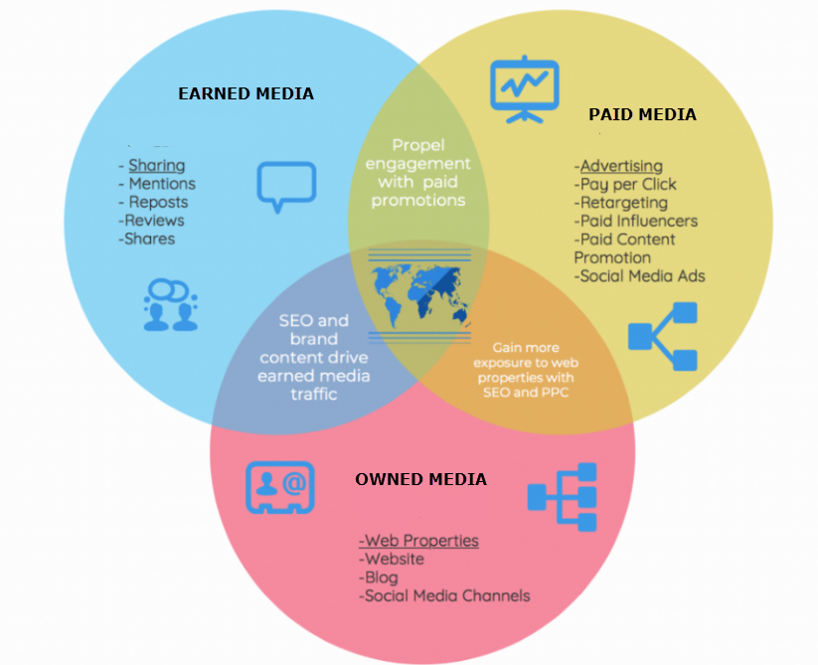
Three main types of media
Notes:
To develop a sound digital strategy today involves understanding a more complex, more competitive buying environment than ever before, with customer journeys including touch- points in many different forms of online presence. To help develop a strategy to reach and influence potential customers online, it’s commonplace to refer to three main types of media that marketers need to consider today (Figure 1.1):

Slide 15
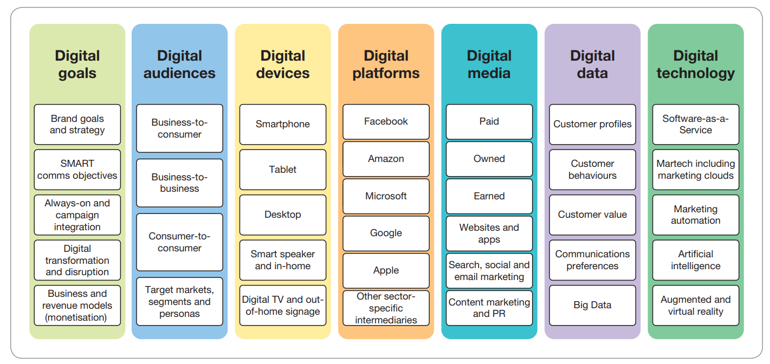
7Ds framework in Digital Marketing
7Ds summarises the key concepts and pillars supporting digital marketing as part of a strategic approach
Notes:
Các nền tảng khác : trò chơi (gaming), ứng dụng kiosk tương tác, bảng chỉ dẫn tương tác, các phụ trang số mang theo người như đồng hồ thông minh, kính thông mình
Desktop, laptop và notebook platforms: Desktop browser-based platform, desktop apps, email platforms, Feed-based và API data exchange platforms, Video-marketing platforms
Mobile phone và tablet platforms: Hệ điều hành và trình duyệt cho mobile, các ứng dụng apps
Các nền tảng khác : trò chơi (gaming), ứng dụng kiosk tương tác, bảng chỉ dẫn tương tác, các phụ trang số mang theo người như đồng hồ thông minh, kính thông mình
Software platforms cho quản trị marketing hiện đại: Các nền tảng trải nghiệm khách hàng, vận hành marketing, các phần mềm trung gian Marketing thẻ (quản lý dữ liệu, quản lý thẻ…), các nền tảng “xương sống” của Marketing (quản lý nội dung, quản lý khách hàng), các dịch vụ cơ sở hạ tầng (dữ liệu, dữ liệu lớn…), dịch vụ Internet (Google, Facebook…)

Slide 16
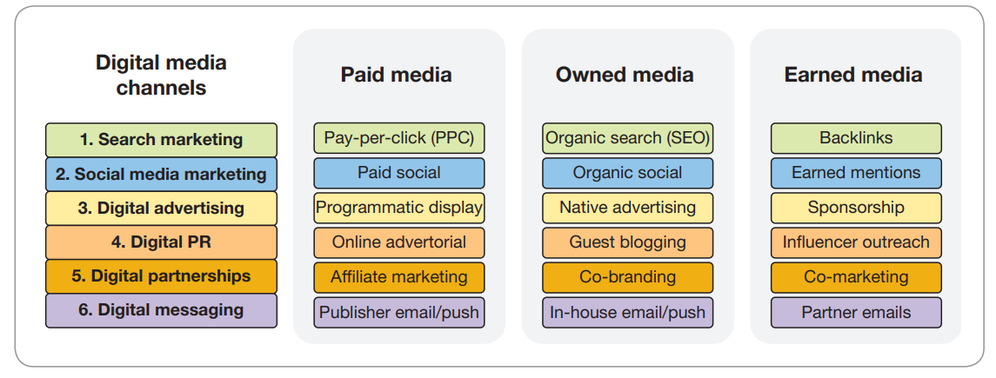
Digital media

Slide 17
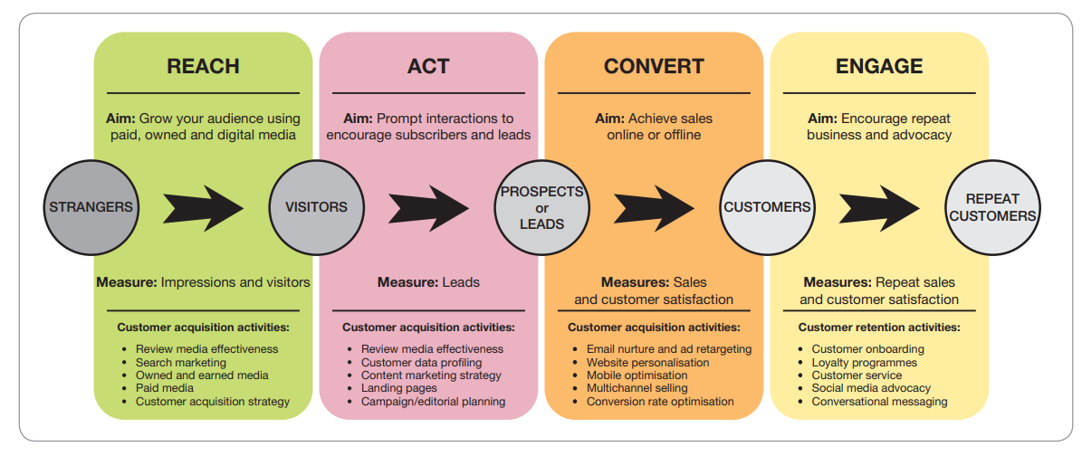
Digital marketing goals and RACE framework
RACE digital marketing framework is a simple way to set and achieve goals across the customer lifecycle from acquisition and customer development to customer retention (Chaffey, 2022): SMART objectives in both DM strategy and campaigns.

Slide 18
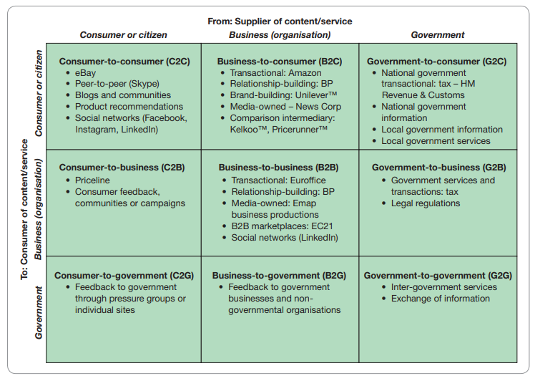
Transactions in Digital Marketing

Slide 19
Benefits of digital marketing (6Is)
Interactivity
Intelligence
Individualization
Integration
Industry restructuring
Independence of location

Slide 20
Benefit of digital communication
In digital campaign, digital communication also have benefits as:
Accountability. Eg: the use of measurement systems known collectively as web analytics
Testing.
Flexibility
Micro-targeting.
Notes:
In terms of deploying campaigns, there are further benefits of digital communications:
Accountability. Digital media are potentially more accountable through the use of measurement systems known collectively as web analytics. Google provides a free tool known as Google AnalyticsTM (www.google.com/analytics) to enable its advertisers to test the
value generated from its ads. Testing. Potentially, testing becomes more straightforward at a lower cost with the option to trial alternative creative executions, messaging or offers. Google offers another free
tool – Google Optimize – to test alternative landing pages. Flexibility. Campaigns can be more flexible, with the capability to change copy or offers during a campaign. Alternative ads can be served within Google to evaluate which works best.
Google Ads also offers dayparting, where ads can be displayed at different times of the day.
Micro-targeting. Alternative messages can be delivered for different audiences accord- ing to what they are searching for. Potentially a company can show a different advert in Google Ads for each term searched.

Slide 21
Key challenges of digital marketing
Complexity
Responding to competitors
Responding to changes in technology and marketing platforms
Cost
Attention
Notes:
Complexity. To enable benefits such as personalisation, testing and dynamic variation in ads through time – time has to go into configuring the campaign, although the search engines provide defaults to enable easy setup. This requires specialist expertise either in- house or at an agency to manage the campaign.
Responding to competitors. Since competitors can also change their approach readily, more resource has to be used to monitor competitor activity. Automated tools known as bid management tools can assist with this – they will automatically check amounts competitors are paying and then adjust them according to predefined rules.
Responding to changes in technology and marketing platforms. Google and the other ad-serving companies innovate to offer better capabilities for their customers. This means that staff managing campaigns need training to keep up to date. Google offers ‘Google Ads Qualified Professionals and Agencies’ so that companies can be certain of a mini-
mum skills level. Cost. Although costs can be readily controlled, in competitive categories the costs can be high, exceeding €10 per click. Attention. While online paid search ads are highly targeted and there is arguably lit- tle wastage, not everyone will view paid adverts; indeed there is a phenomenon known as ‘banner blindness’ where web users ignore online ads. Engaging with the audience through advertising is also a problem in social networks and other publisher sites, which can lead to a very low rate of people clicking on ads.
Xây dựng và bảo vệ uy tín/hình ảnh của DN
Bảo mật và bảo vệ thông tin
Sự phụ thuộc vào công nghệ và các platform
Dư thừa dữ liệu
Xu hướng của nền kinh tế tức thì
Khó kiểm soát
Các vấn đề đạo đức

Slide 22
OVERVIEW OF DIGITAL MARKETING STRATEGY
Key features of digital marketing strategy
Different forms of functionality of digital presence
Challenges in developing and managing digital marketing strategy
A strategic framework for developing a digital marketing strategy

Slide 23
Key features of digital marketing strategy
Be aligned with business and marketing strategy
Use clear objectives for business and brand development and the online contribution of leads and sales for the internet or other digital channels
Be consistent with the types of customers who use and can be effectively reached through the channel;
Define a compelling, differential value proposition for the channel
Specify the mix of online and offline communication tools
Support the customer journey using the digital channel in combination with other channels
Manage the online customer lifecycle
Notes:
Phù hợp với chiến lược kinh doanh và chiến lược marketing chung của doanh nghiệp
Có mục tiêu rõ ràng cho phát triển doanh nghiệp và phát triển thương hiệu, phạm vi và mức độ đóng góp của digital marketing trong chiến lược kinh doanh chung
Xác định rõ khách hàng mục tiêu cần hướng đến thông qua các kênh digital
Xác định rõ đề xuất giá trị trực tuyến OVP
Xác định cụ thể hỗn hợp các công cụ truyền thông online và offline để đạt được các mục tiêu cụ thể
Tối ưu trải nghiệm KH trong suốt hành trình mua hàng bằng kết hợp các kênh online và offline
Quản lý vòng đời khách hàng hiệu quả.

Slide 24
Different forms of functionality of digital presence
Transactional e-commerce
Services-oriented relationship-building for lead-building and support
Brand-building
Publisher or intermediary site
Social network or community

Slide 25
Challenges in developing and managing digital marketing strategy
There are unclear responsibilities for the many different digital marketing activities
No specific objectives are set for digital marketing.
Insufficient budget is allocated for digital marketing
Budget is wasted
New online value propositions for customers are not developed
Results from digital marketing are not measured or reviewed adequately
An experimental rather than planned approach is taken to using
e-communications, with poor integration between online and offline marketing communications

Slide 26
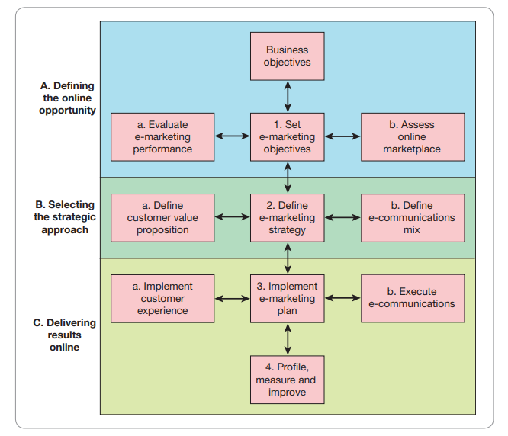
A strategic framework for developing a digital marketing strategy

Slide 27
Key communications concepts for DM
Inbound Marketing
Permission Marketing
Content Marketing
Digital Audience Engagement
Always-on marketing

Slide 28
Summary
Chapter 1 focuses on clarifying the concept of Digital Marketing, the digital transformation process and the 7 main pillars of Digital Marketing, the benefits and challenges of applying Digital Marketing in the overall Marketing strategy of the entire enterprise.
In addition, this chapter also provides a framework for developing a Digital marketing strategy as a foundation for the Digital Marketing strategic decisions mentioned in the following chapters.

Slide 29
Chapter references
Chaffey D. & Ellis-Chadwick F. (2022). Digital marketing - Strategy, Implementation and Practice (8th edition). Pearson. UK
Strauss, J., & Frost, R. (2014). E-marketing (7th Ed.). Pearson.

Slide 30


